Slide 1
Parallel Probabilistic Data Sampling
Implementation and Scaling Study
Group No. 4
Project supervisor:
Prof. Preeti Malakar
Prof. Soumya Dutta
Group members:
- Dasari Charitambika
- Divya Gupta
- Om Shiv Verma
- Palak Mishra
- Siddharth Pathak

Slide 2
Project Overview
Progress
Implementing various sampling algorithms in parallel
Visualisation and numerical methods for evaluating correct implementation
Scaling study of implementation
Evaluation & Visualisation:
Completed:
Reconstruction using Random sampled data points
SNR plot for SRS
Volume rendering on reconstruction
Isocontour based on reconstruction
Upcoming:
Reconstruction using Value based and Joint Multi-criteria sampling.
SNR plot Value based and Joint Multi-Criteria
Sampling
Percentile plot - original v/s reconstructed
Implementation:
Completed:
Simple Random Sampling
Value-based importance Sampling
Upcoming:
Smoothness-based Importance Sampling
Joint Multi-Criteria Sampling

Slide 3
Value-based Importance Sampling
Simple Random Sampling
Reading Data
Reading Data
Scatterv
Scatterv
Create
Histogram
Create
Histogram
SRS
SRS
SRS
Allreduce
Gatherv
Importance
sampling
Importance
sampling
Writing Data
Gatherv
Writing Data

Slide 4
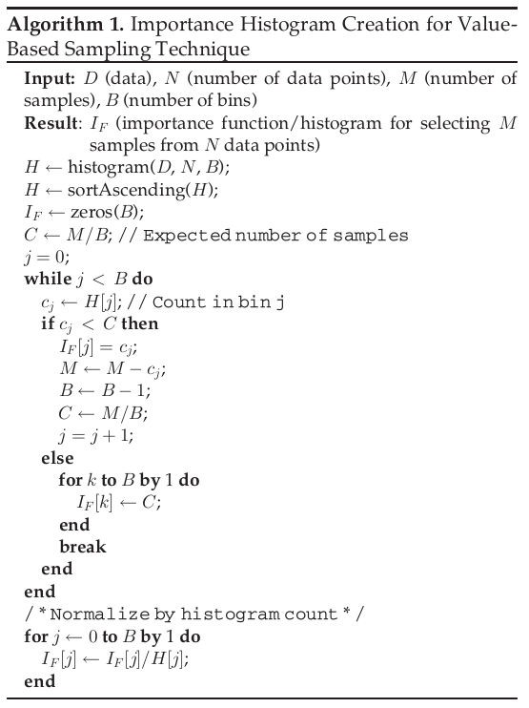
Value-based Importance Function
Source: https://ieeexplore.ieee.org/document/9130956

Slide 5
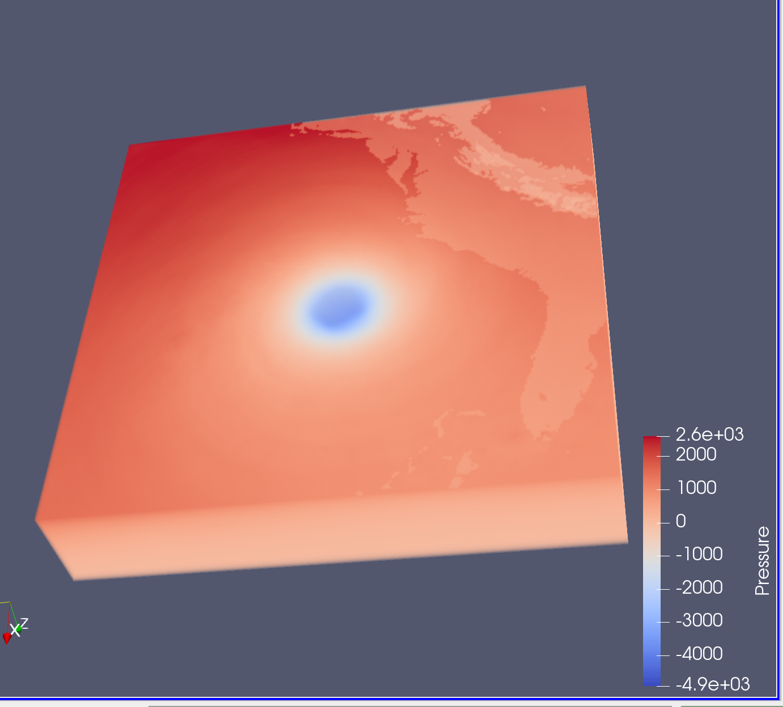
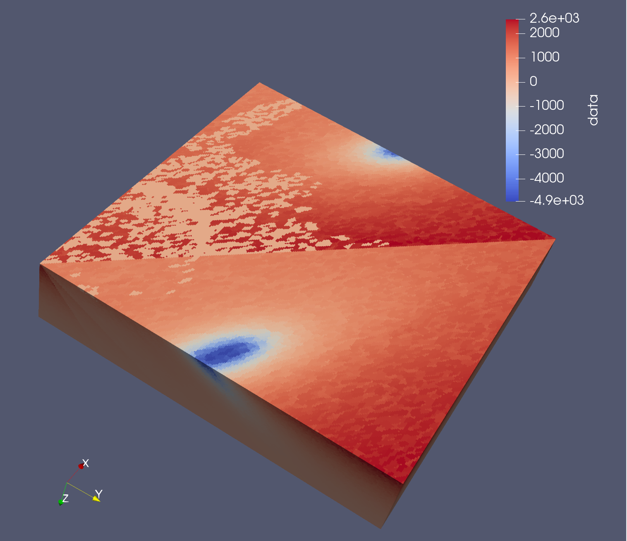
Reconstruction-Based Visualization :
Perform nearest neighbor-based technique on sampled data points
We can achieve interpolation using scipy.interpolate
Then convert points to polygonal mesh using 3D Delaunay triangulation.
We can do apply 3D Delaunay triangulation using scipy.spatial import Delaunay to create a mesh in python, or we can also directly implement in Paraview during visualization
Original Data
From 5% randomly sampled data points

Slide 6
After Reconstruction (to be done in Paraview)
We allow traditional volume based and isocontour-based visualizations for the exploration of the dataset.
Volume based visualization:
Ray casting based technique.
Modify Transfer function to explore features in the reconstructed volume.
Isocontour-Based Visualization:
We can specify feature-specific isovalues to render isosurfaces and visualize them interactively

Slide 7
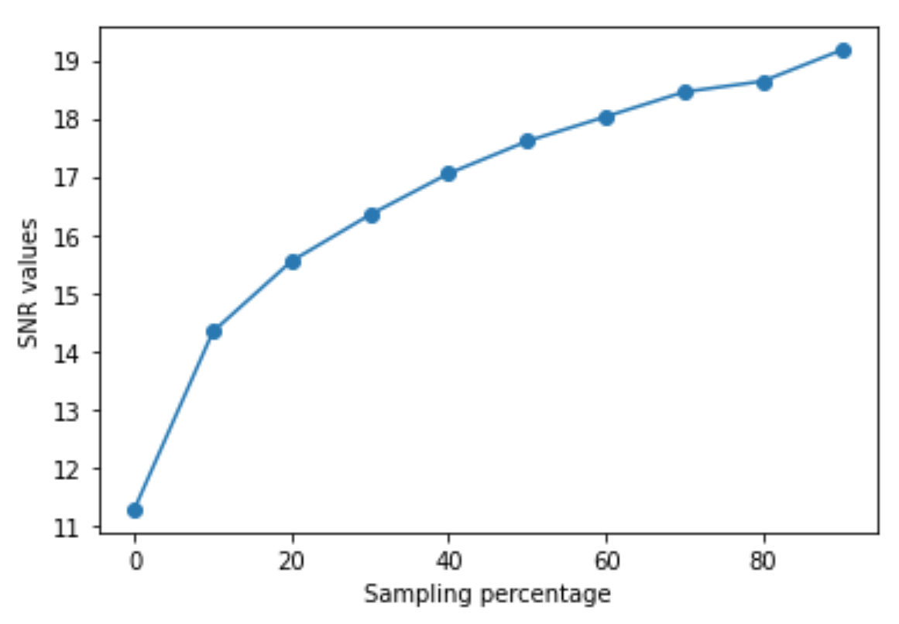
Evaluation:
To estimate the quality of reconstruction, We will use SNR function :
SNR = 20*log₁₀σ_{raw}/σ_{noise}
where σ_{raw} is SD of original data and σ_{noise} is SD of error
Larger values indicate better reconstructions.

Slide 8
Current Problems
Code: https://github.com/omsv135/Parallel-Probabilistic-Data-Sampling
Long time taken for reconstruction from sampled data points for analysis.
Need to work on dimension of output of reconstructed data.
How can we do a scaling study? Simply storing timestamps or some library in python3 would be a better choice.
Efficient (and correct) implementation of mixed sampling.

Slide 9
Work Distribution
Student’s Name | Corresponding Contribution
Siddharth Pathak | Implementation logic of algorithms in parallel
Divya Gupta Dasari Charithambika | Reconstructed Visualization and Evaluation as given in the paper. To perform a scaling study of all the parallelised algorithms.
Om Shivam Verma Palak Mishra | Parallelisation of the sampling algorithms using mpi4py & knowledge of vtk for loading and storing

Slide 10
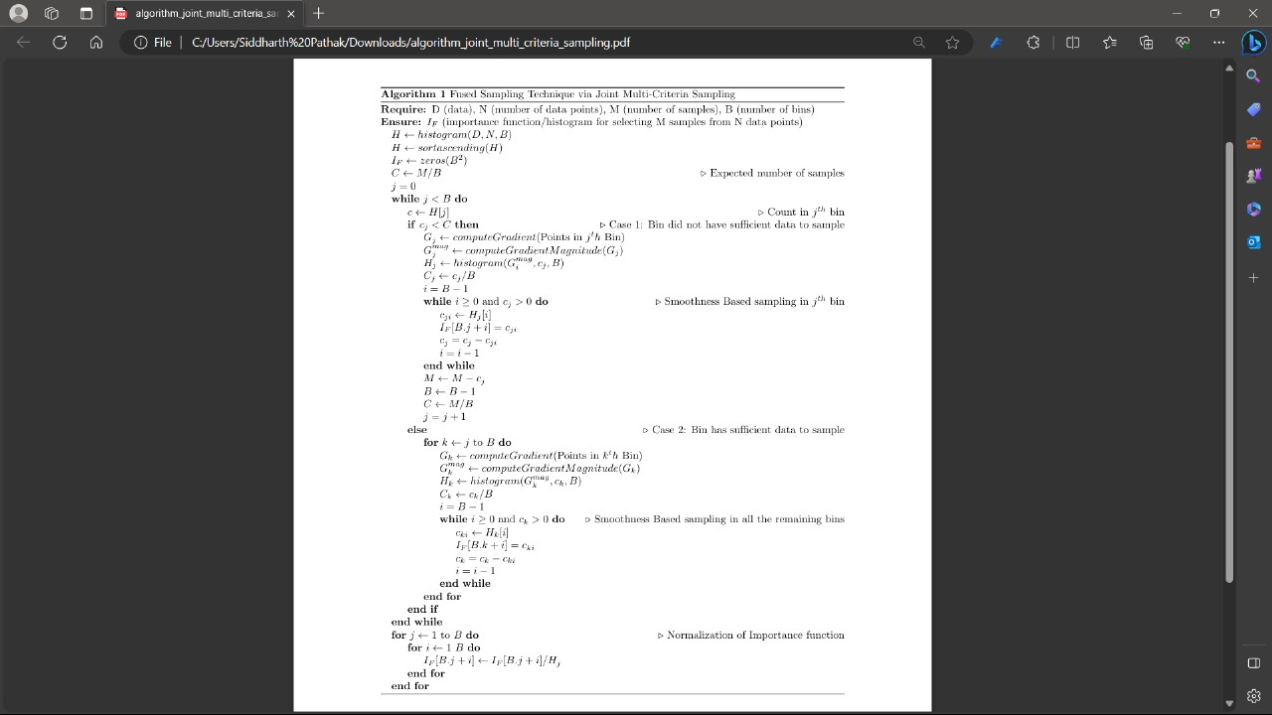
Joint multi-criteria sampling
Next Steps
- Smoothness-based random sampling
- Joint multi-criteria sampling
- Scaling Study
- Remaining result evaluation through visualization.

Slide 11
Thank You

